Slide 1
ANTHONY LANGGA FLORA LEE
IMPORTANCE OF INFORMATION SECURITY

Slide 2
Flora Lee
Graduating Senior @ SJSU
Major: Business Administration - Management Information Systems
MIS = biz * (info + tech + people)
Special Interests:
Information Security
Project Management
Lead a security team to shape the future’s information security policies

Slide 3
Anthony Langga
Looking for a super power
Information Security/Programming
Looking for a challenge
Computer Science Major @ SJSU
Information Security Club President
Graduating in Fall 2015
Hoping to lead the industry shortly after graduation

Slide 4
The Problem
Lack of cyber-security professionals
Technology age without security
Attacks by internal and external organizations
Privacy is dissapearing

Slide 5
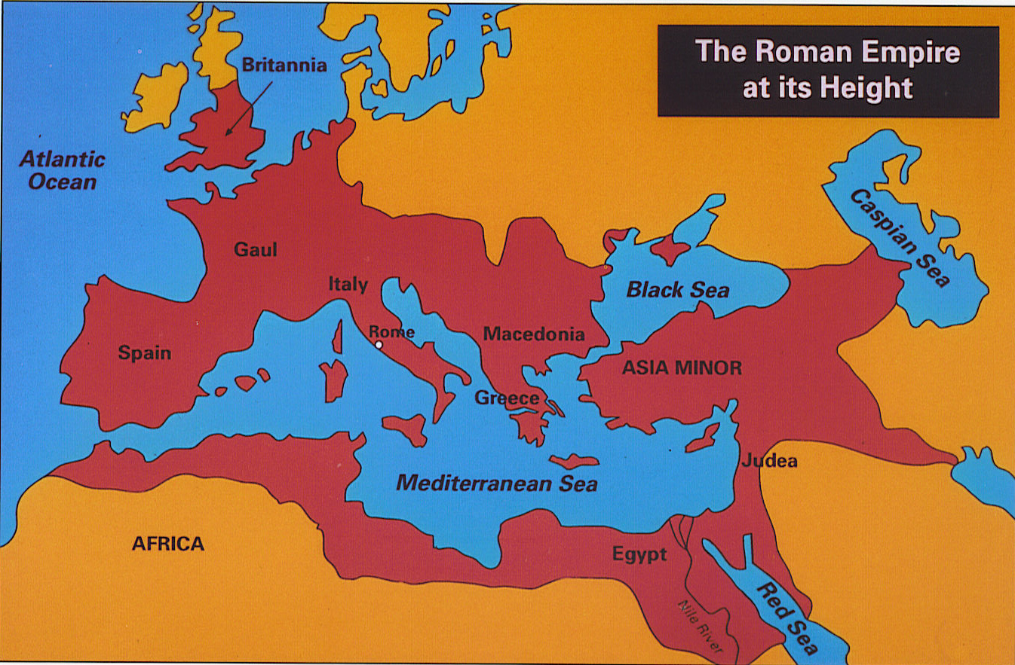
Fall of Ancient Rome
http://www.mitchellteachers.org/WorldHistory/AncientRome/Images/MapRomeEmpireAtHeight.jpg

Slide 6
Fall of Ancient Rome
Empire too LARGE
Hard to govern effectively
Corruption in the military
Dishonest generals & non-Roman soldiers
The rich became lazy & had little interest in trying to solve Rome problems

Slide 7
How does it relate?
Thinly Spread
There are too many engineers
Not enough security professionals
Lead to our own downfall

Slide 8
Downfall by who?
Internal Struggles
NSA has been intercepting citizen phone calls and internet communication
External Struggles
Stuxnet: 2010
Created by U.S and Israeli
Against Iran Nuclear Facilities
Red October: 2012
Cyber-espionage: Gather intelligence/secrets
Victims: Eastern Europe, the former USSR republics, Central Asia, Western Europe, and North America

Slide 9

Private Sector
Insecure Applications
Viruses and Exploits
9&10 News warned the public about a recently created fake Flappy Bird Game
Dissapearence of Privacy

Slide 10


Social Networks

Slide 11

Targets Today:
http://securityaffairs.co/wordpress/22180/security/nist-critical-infrastructure.html

Slide 12
Cyber professionals say…
67% of their agency is not ready to fend off hackers
74% preventing data theft is their top priority
49% of agency breaches are caused by a lack of user compliance

Slide 13
Cyber Security Framework
“Cyber threat is one of the most serious economic and national security challenges we face today as a nation”
-President Obama

Slide 14
Solution
Privacy should be normal (The mindset)
A focus on cyber-security curriculum in middle school, high school, and college levels.
Government support and change
More security professionals

Slide 15
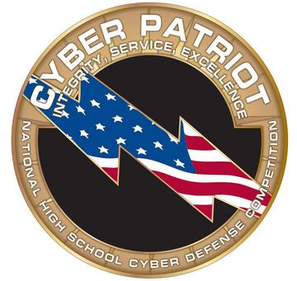
Initiative - Cyber Patriot
National High School Cyber Defense Competition
Creator: Air Force Association

Slide 16

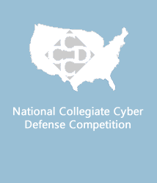

College Level Initiatives
Cyber Student Volunteer Initiative
Collegiate Cyber Defense Competition
Cyber quest

Slide 17
More professionals
Smart people
Think outside the box
More professionals can lead to more secure technology

Slide 18

http://techfun.biz/technology-timeline-future/

Slide 19
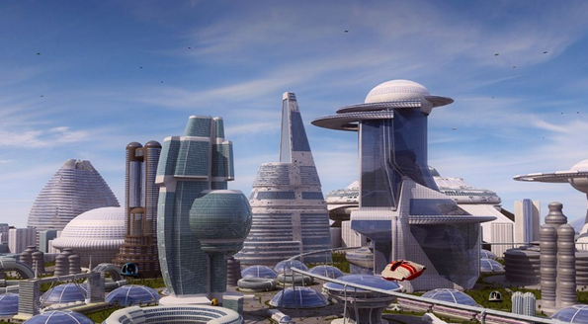
http://gatwaytothefuture.wordpress.com/

Slide 20
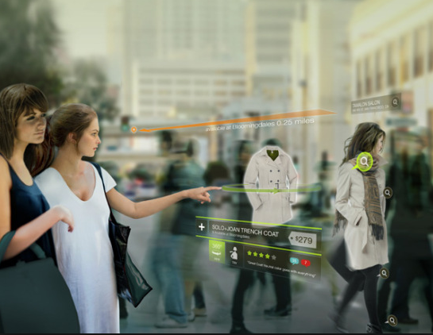
www.flowingdata.com

Slide 21


Slide 23
References
http://www.historylearningsite.co.uk/fall_of_ancient_rome.htm
http://www.fedtechmagazine.com/article/2013/11/11-concerning-cybersecurity-stats-about-federal-government
https://www.eff.org/nsa-spying
http://www.9and10news.com/story/24716562/virus-threat-warning-for-fake-flappy-bird-apps
https://www.dhs.gov/news/2013/12/16/dhs-announces-expansion-cyber-student-volunteer-initiative

Slide 24
Contact Information
Flora Lee
Email: Flora.lee@sjsu.edu
Cell Phone: (408) 981-9413
Anthony Langga
Email: Anthony.Langga@sjsu.edu
(408) 607 – 5657

